Slide 1

Weather App Monitor
A JS WEB BASED APP
A project (semester 5) submitted in partial fulfilment of THE DEGREE IN BTECH IN COMPUTER SCIENCE AND ENGINEERING
UNDER CHIEF GUIDANCE OF
Mrs. Suruchi Sabherwal
BY Shikhar Rastogi
And Rajya Vardhan Singh

Slide 2
OVERVIEW
INTRODUCTION
WEB MODEL OF WEATHER MONITOR
JAVASCRIPT USED / APIs
HOW IT WORKS
RESULT : THE APP

Slide 3
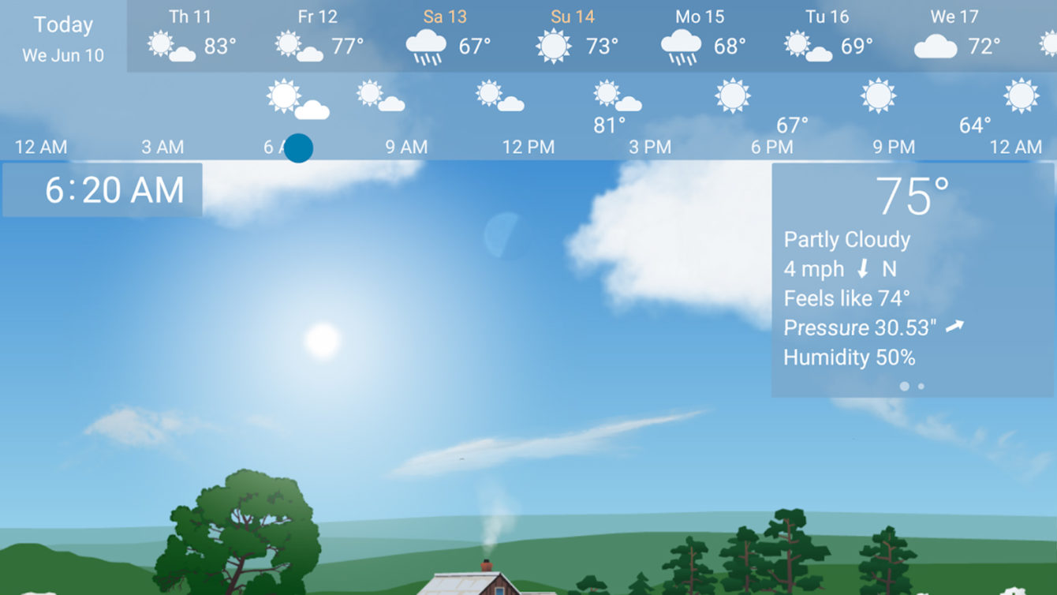
INTRODUCTION
Knowing the weather is something that we all pretty much need to know. Smartphone weather apps and weather widgets have been steadily improving over the years.the weather widgets generally look better and more modern. These days, you can get some crazy good radar, even if
Dark Sky doesn’t be seen on radar of andriod.
The free default weather app that comes pre-installed is usually a pretty solid choice for basic forecast tasks, but there's a variety of third-party weather apps worth checking out; either for their stylish design or additional features.

Slide 4
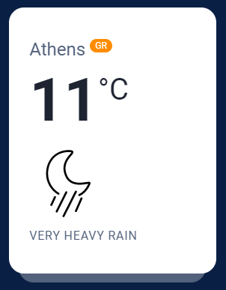
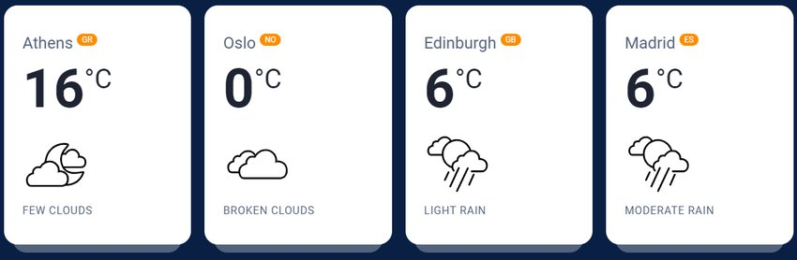
WEB MODEL OF WEATHER MONITOR
A WEB BASED WEATHER MONITOR is an automated version of the traditional weather station. There are plenty of weather apps offered by Windows 10 that offer basic and detailed forecasts. While some just present you with the basic conditions, others would offer a more detailed view of the situation in an attractive manner. We have tried to make a prototype of website which uses api key to request information using javascript , JSON/AJAX and uses the deskstop location to tell the current temperature
Here we have requested api key from OpenWeatherMap and backened the web interface using vanila javascript .

Slide 5
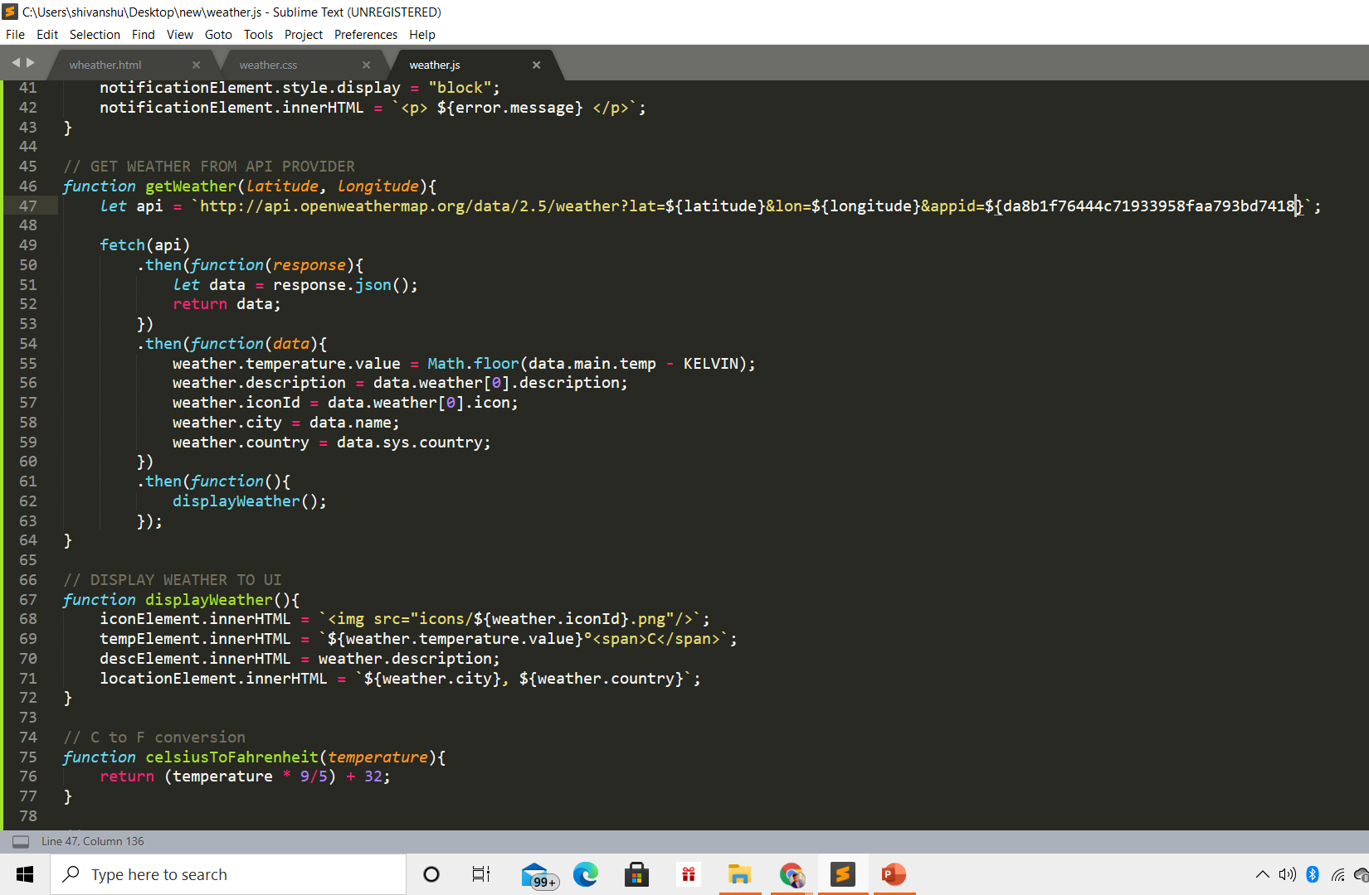
JAVASCRIPT USED / APIs
We’ll start with the assumption that the list is empty. That said, it has never run any AJAX request in the past. In such a case, we’ll execute a request to the OpenWeatherMap API and pass the following parameters:
The city name (e.g. athens) or the comma-separated city name along with the country code (e.g. athens,gr) which will be the value of the search field
The API key. Again, you should use your own key to avoid unexpected errors due to API call limits.
The unit of temperature for the requested city. In our case, we’ll go with Celcius.
With all the above in mind, by following the API documentation our request URL should look something like this:

Slide 6
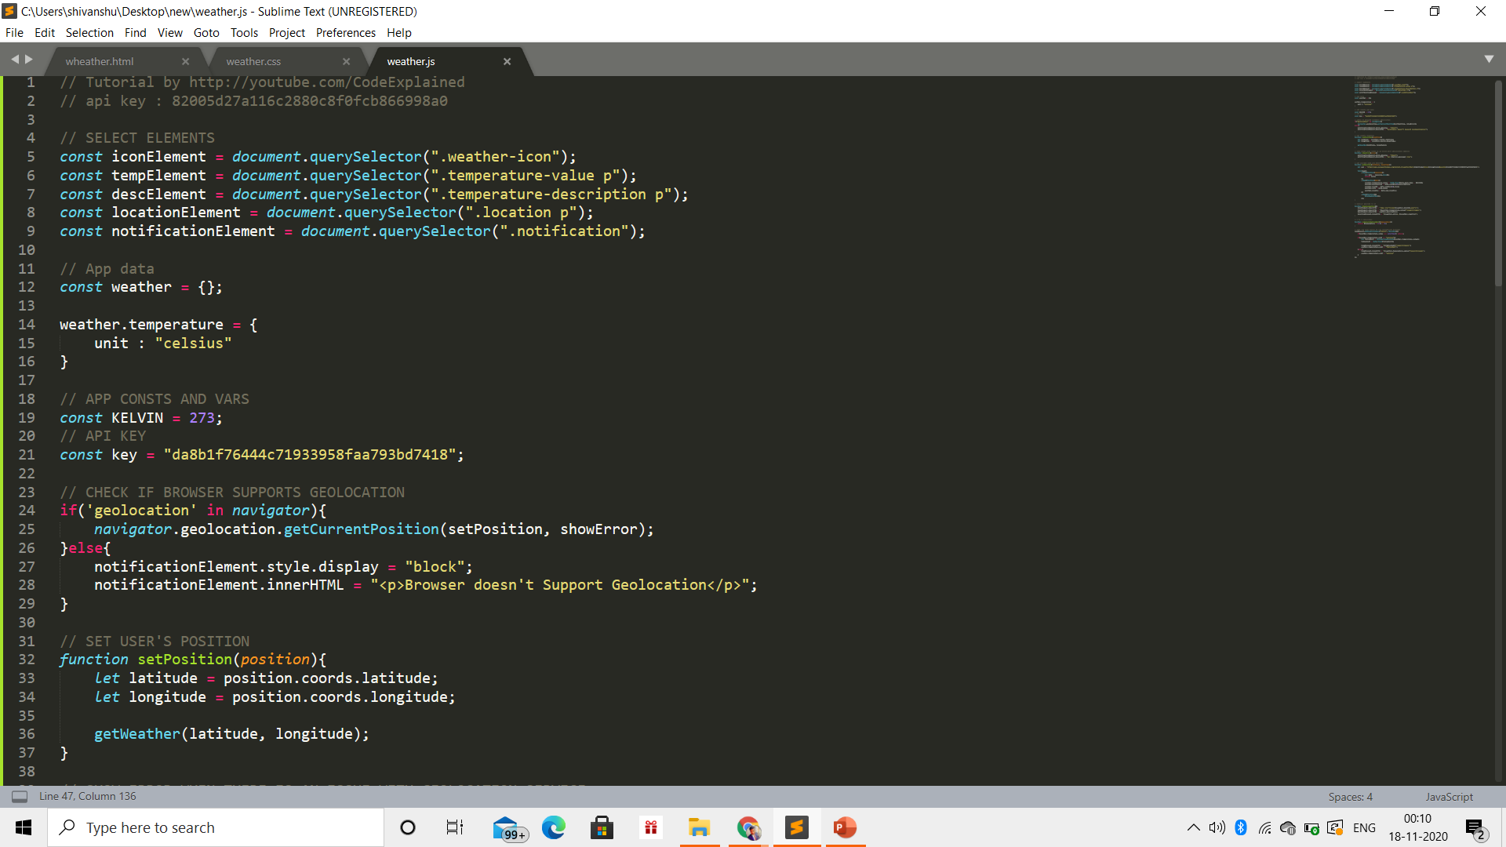
If you look again at the response visualization above, you’ll notice that the API returns an icon code (e.g. "50d") which holds the current weather condition for the target city. Based on this code, we’re able to construct the icon URL and display it in the card via the img tag.
Inside the .city-name element of each list item, we’ll append the data-name attribute with value the cityName,countryCode (e.g. madrid,es). Later we’ll use this value to prevent duplicate requests.

Slide 7
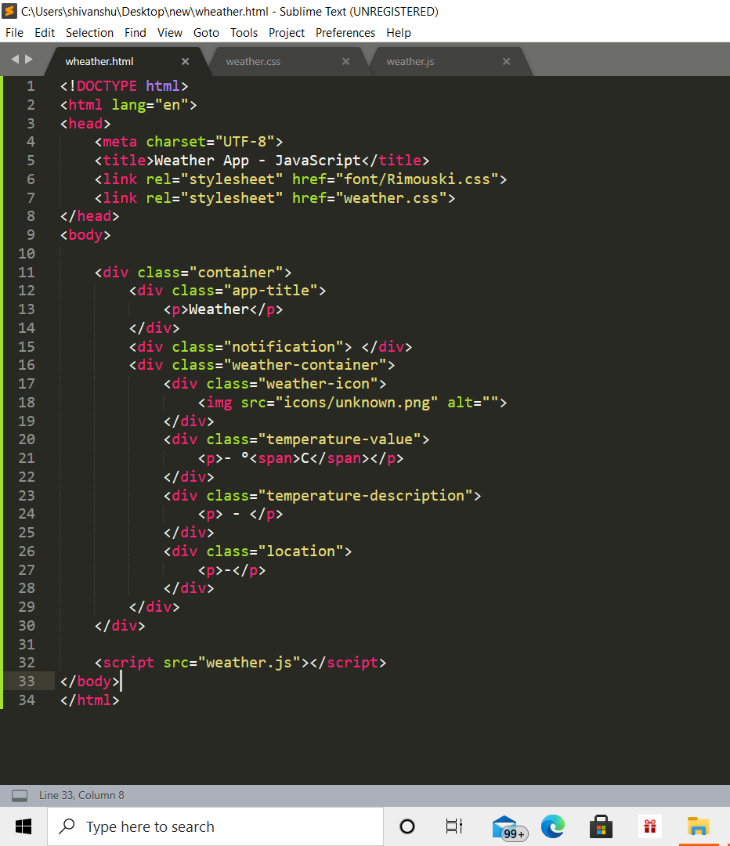
HOW IT WORKS
MARKUP CODE :
WE HAVE DIVIDED THE DIFFERENT LAYERS IN DIFFERENT DIVISION TAGS AND CREATED A BASIC SETUP FOR REST OF THE WORK

Slide 8
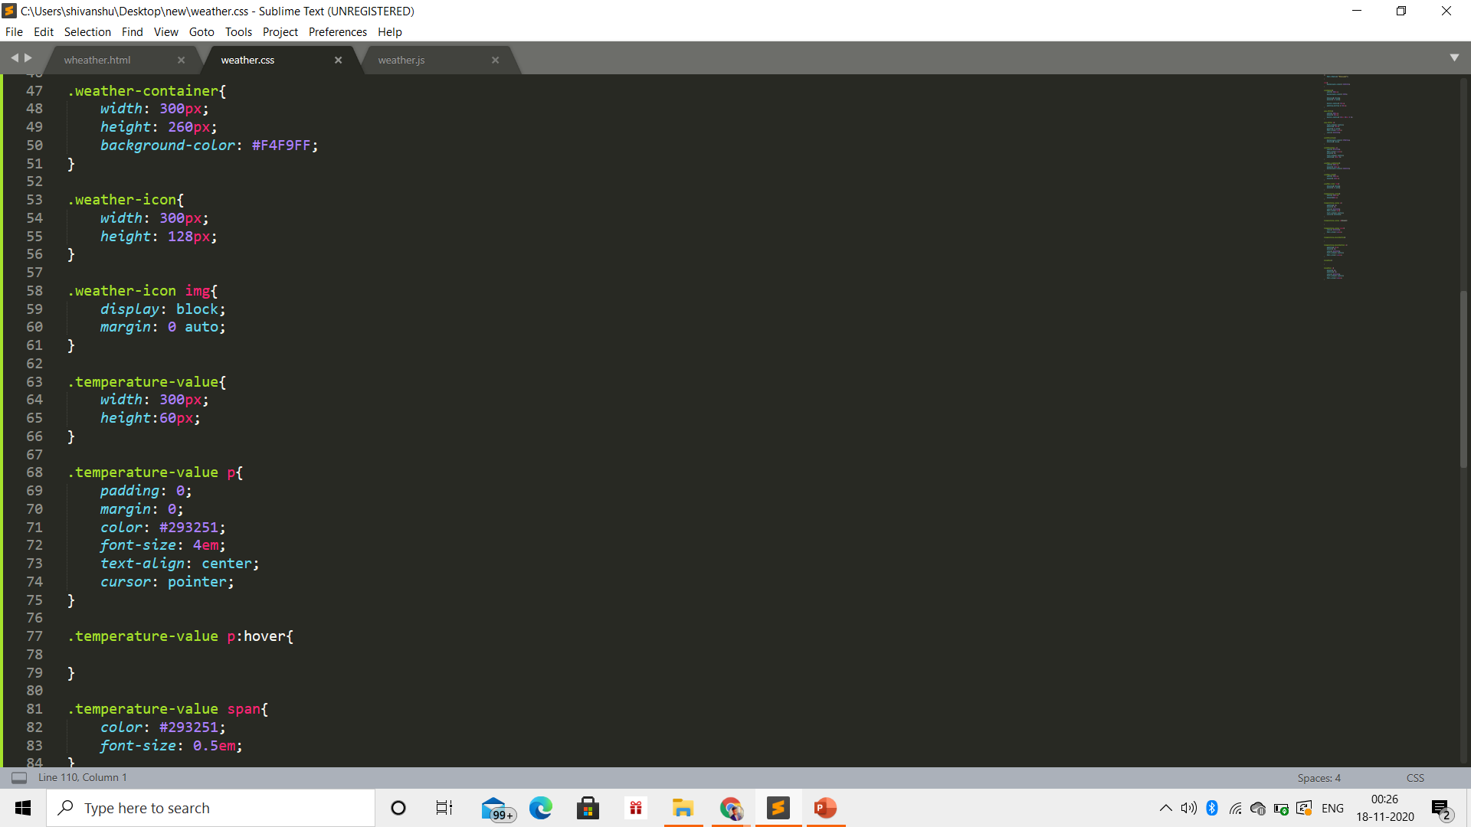
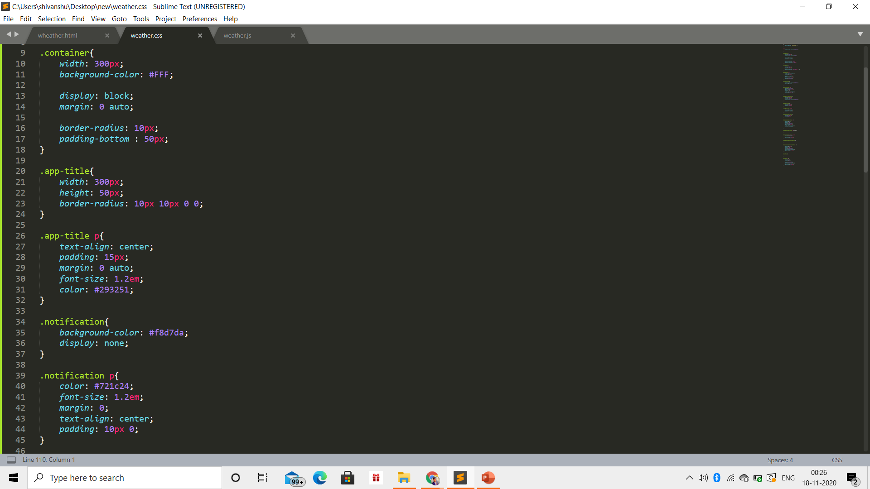
HOW IT WORKS
CSS CODE :
First, we’ll add some straightforward styles to the elements of the first section. column will look like a card with a bottom shadow that will be added via the ::after pseudo-element.
Inside the card, we’ll place weather information about the requested city. These will come from our request, apart from the icons. Those icons, which as mentioned above are grabbed from Envato Elements, will show the current weather condition of this city and match the equivalent OpenWeatherMap icons.

Slide 9
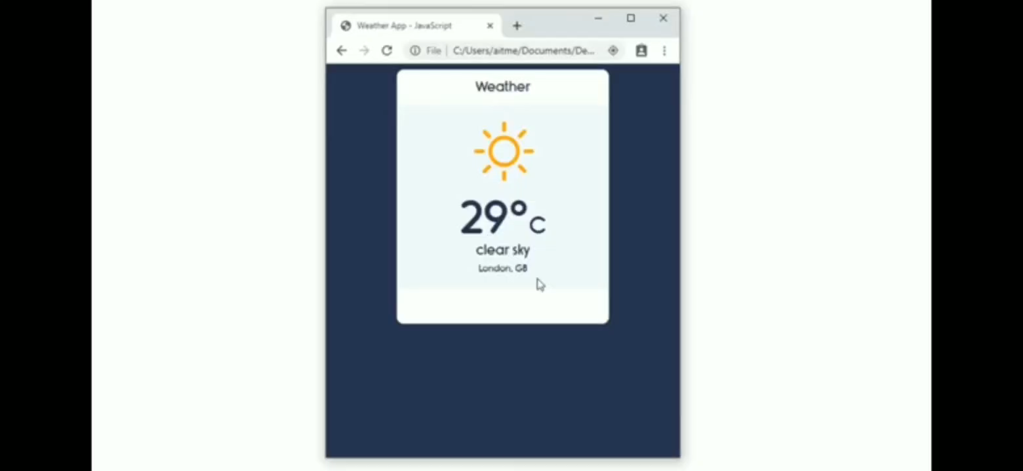
RESULT : THE FINAL CHAPTER THE WORKING APP

Slide 10
Thank you

